Slide 1
Real Electricity Nodal price
Principle Components for real ENP (2019 & 2020), Greenfield optimization ENP and Brownfield optimization ENP

Slide 2
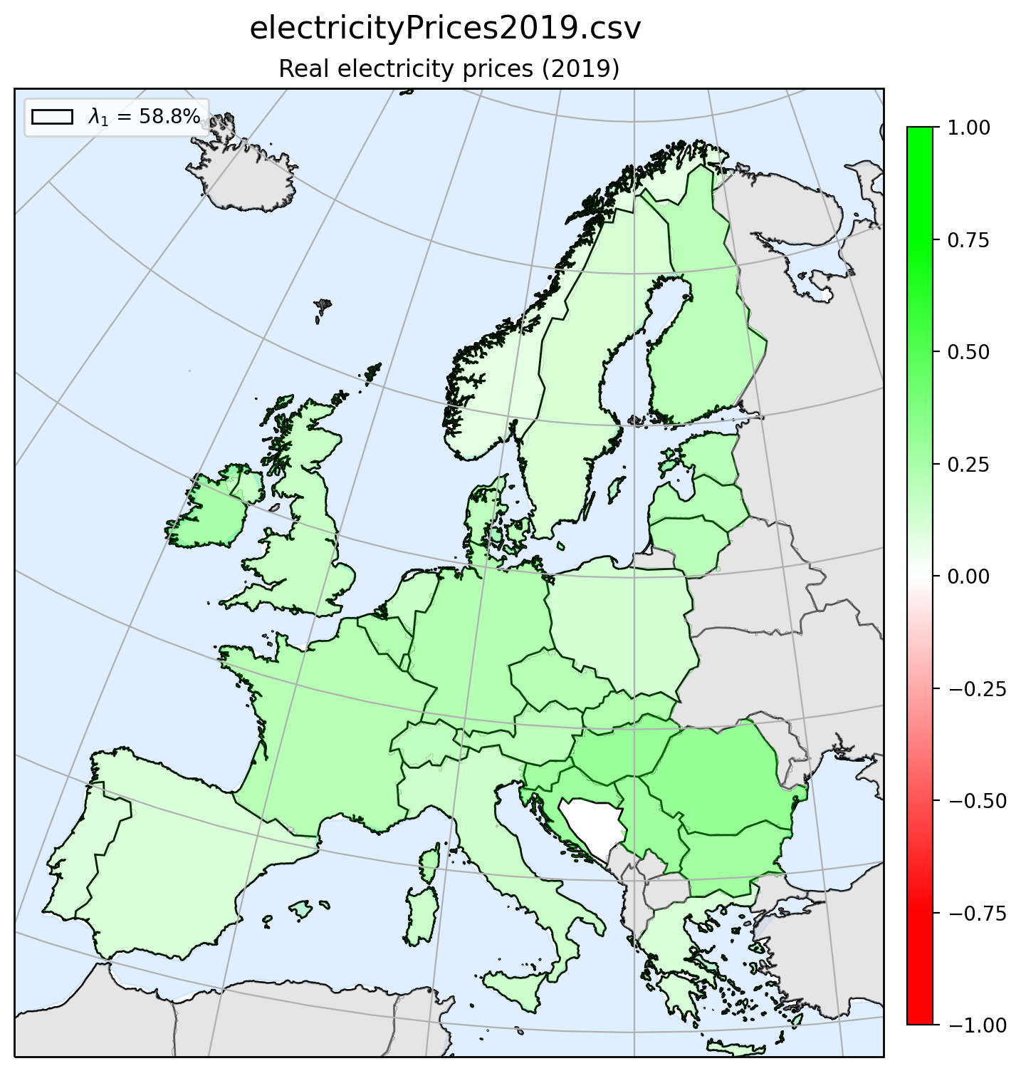
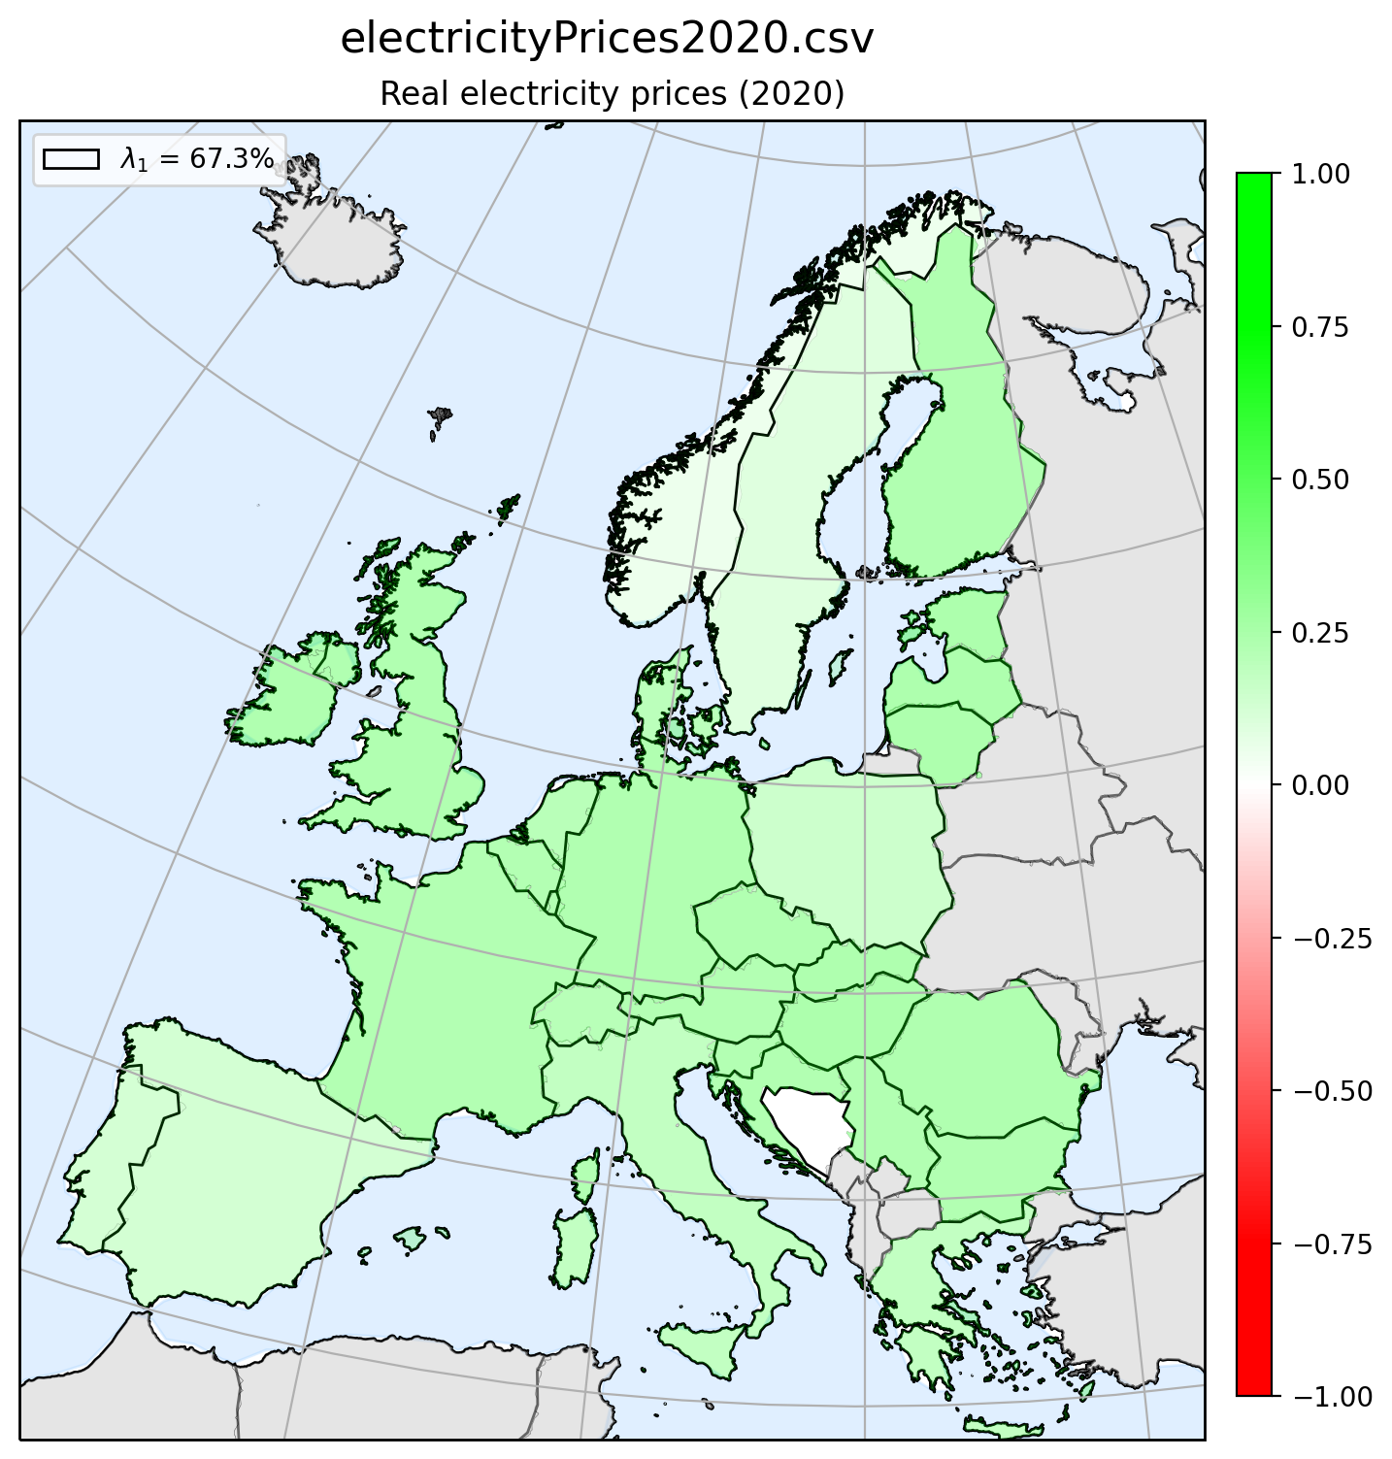
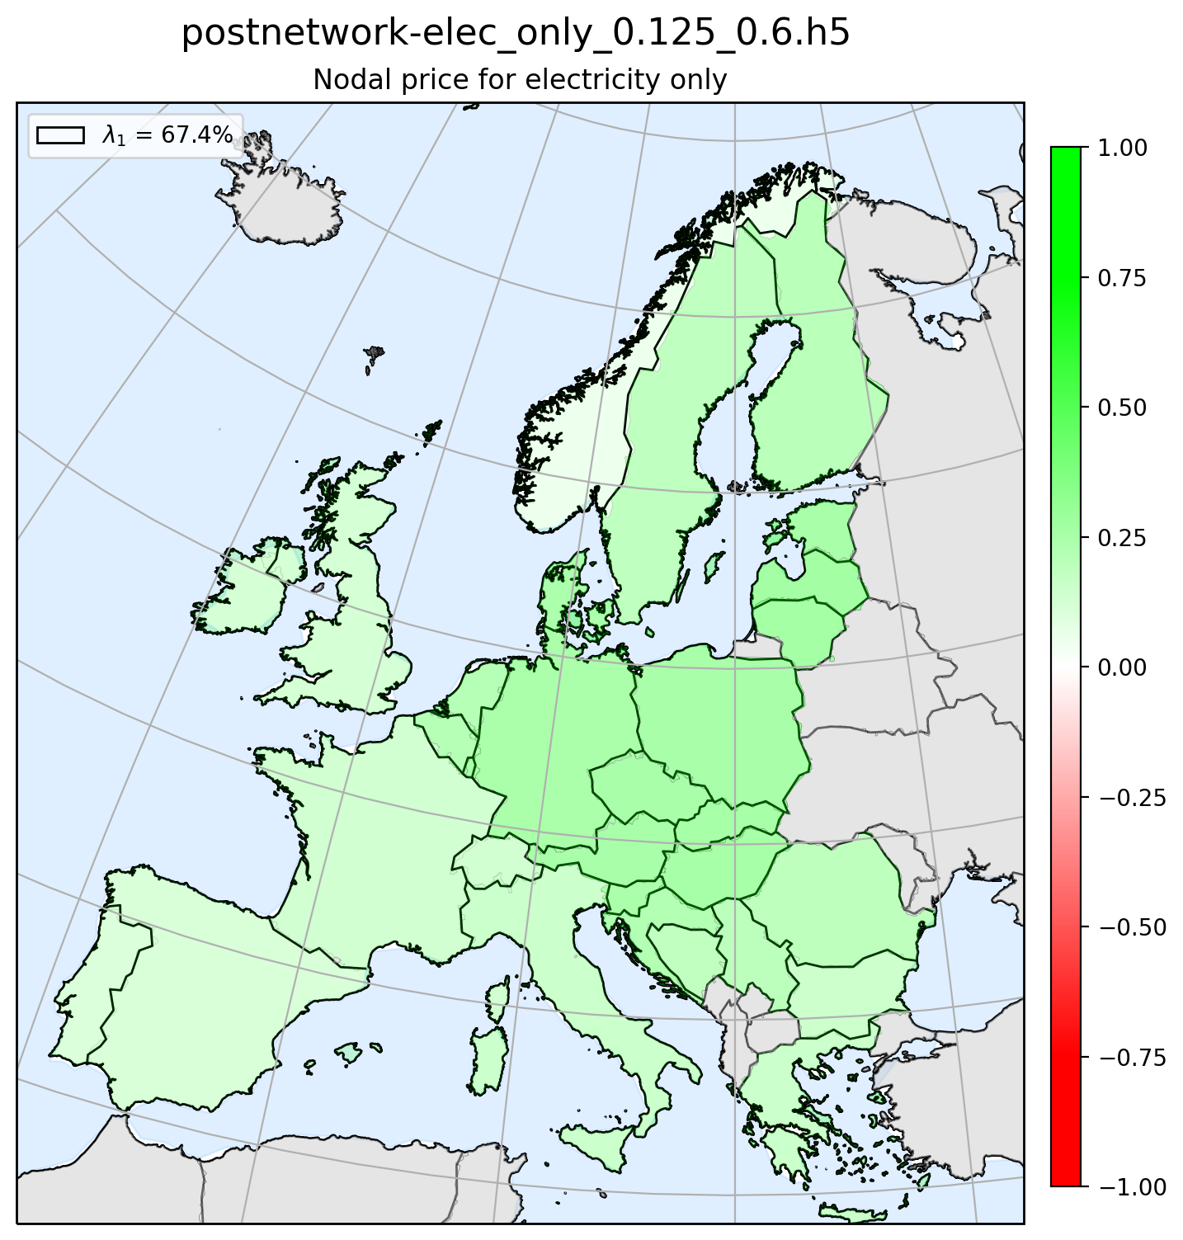
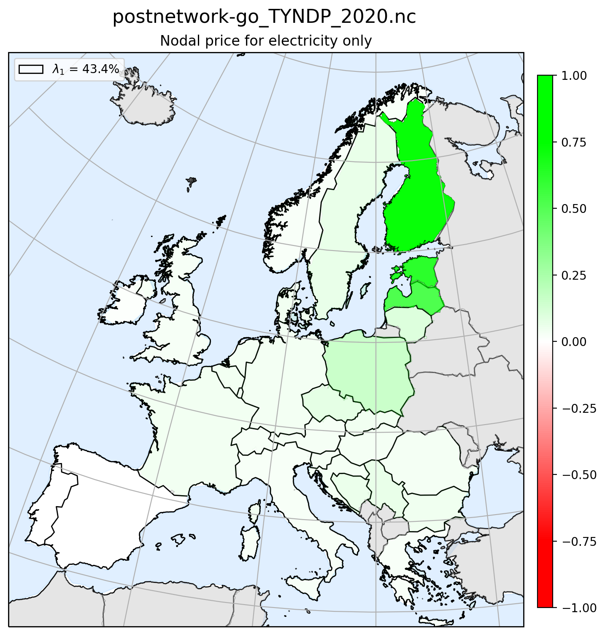
Principle Component 1 - Map plot
Real ENP 2019
Real ENP 2020
Greenfield
Brownfield

Slide 3
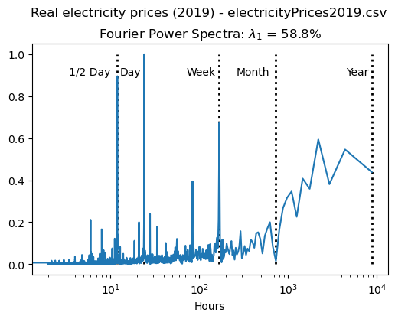
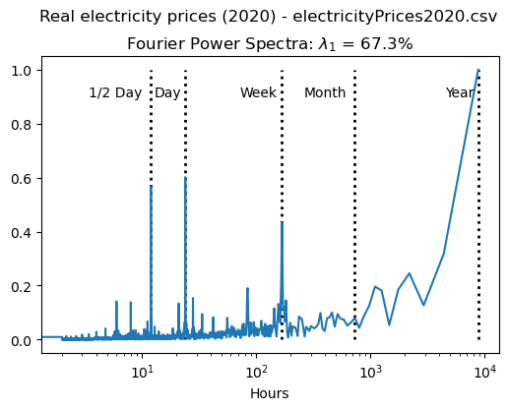
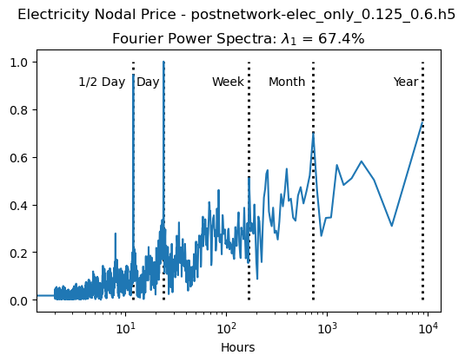
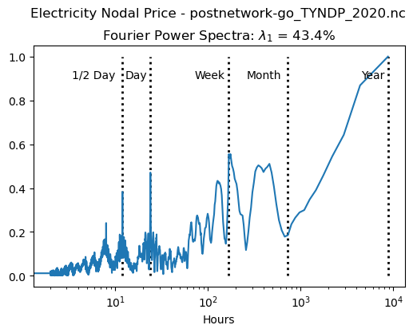
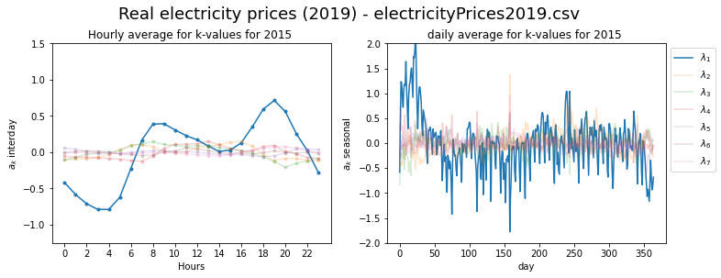
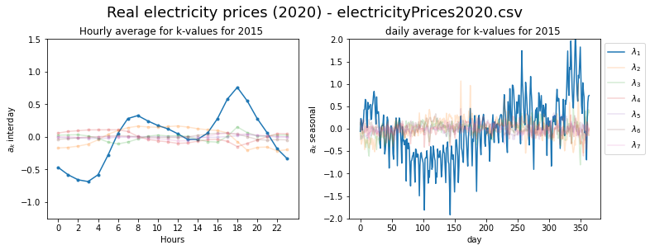
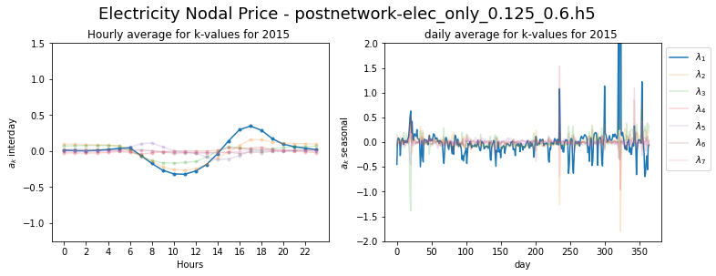
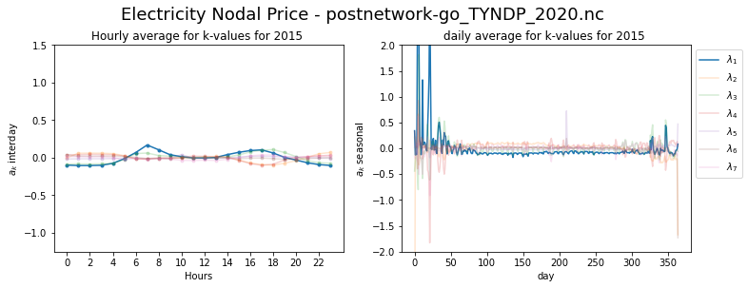
Principle Component 1 - FFT & Seasonal plot
Real ENP 2019
Real ENP 2020
Greenfield
Brownfield

Slide 4
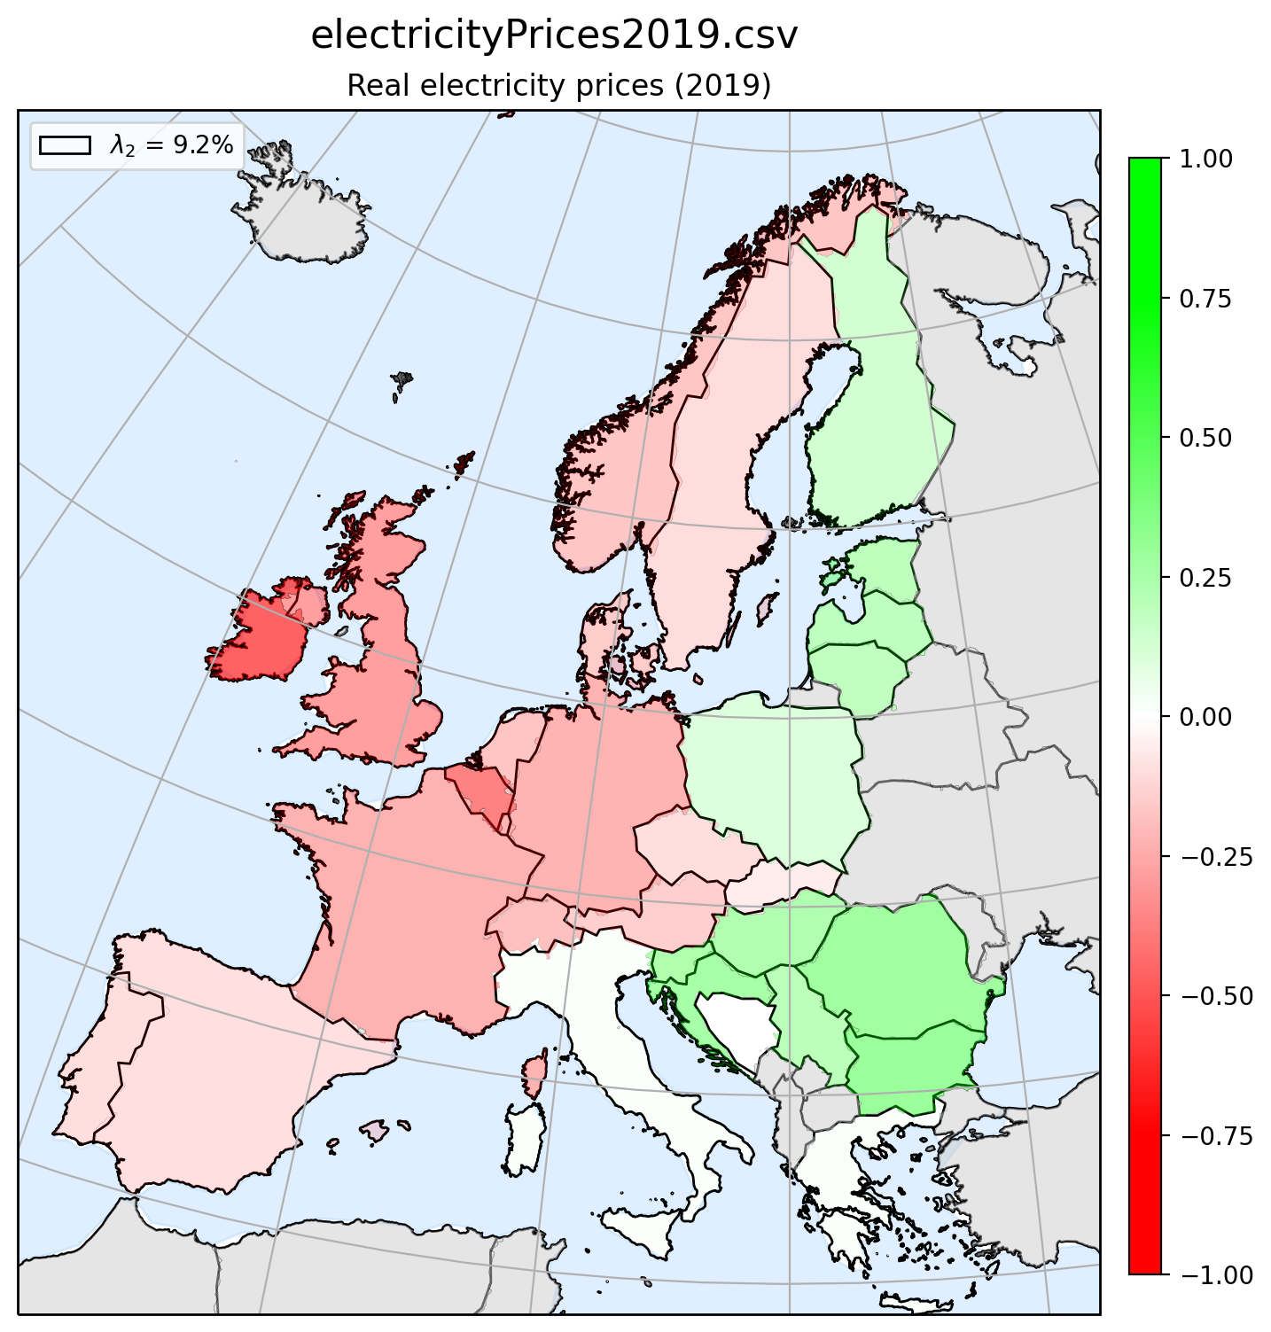
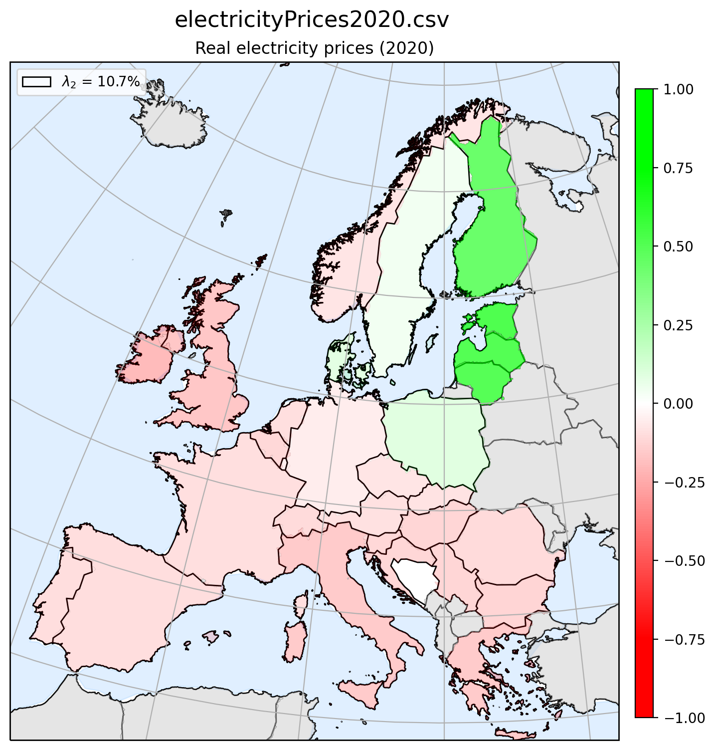
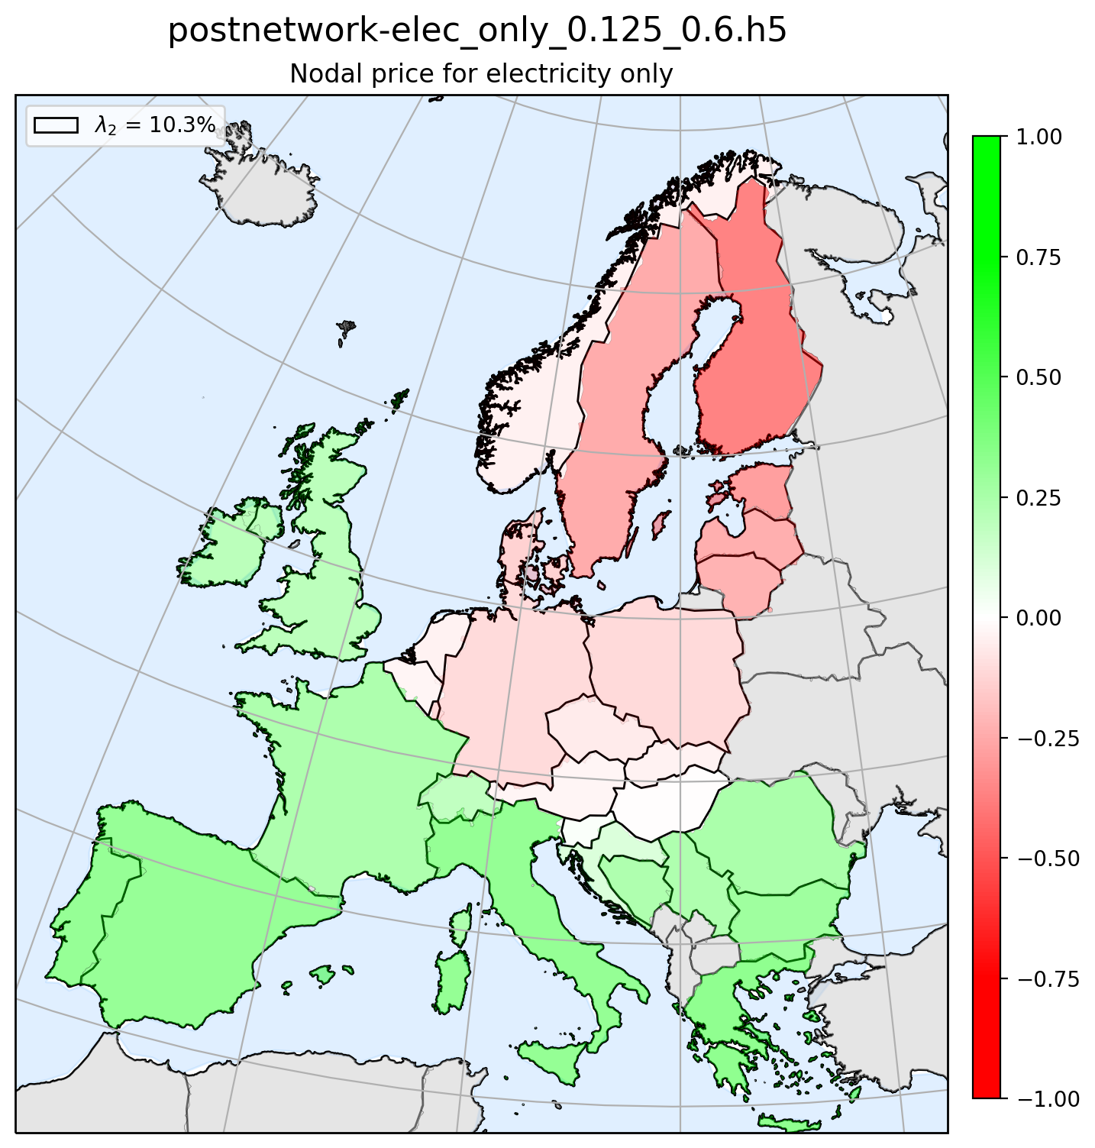
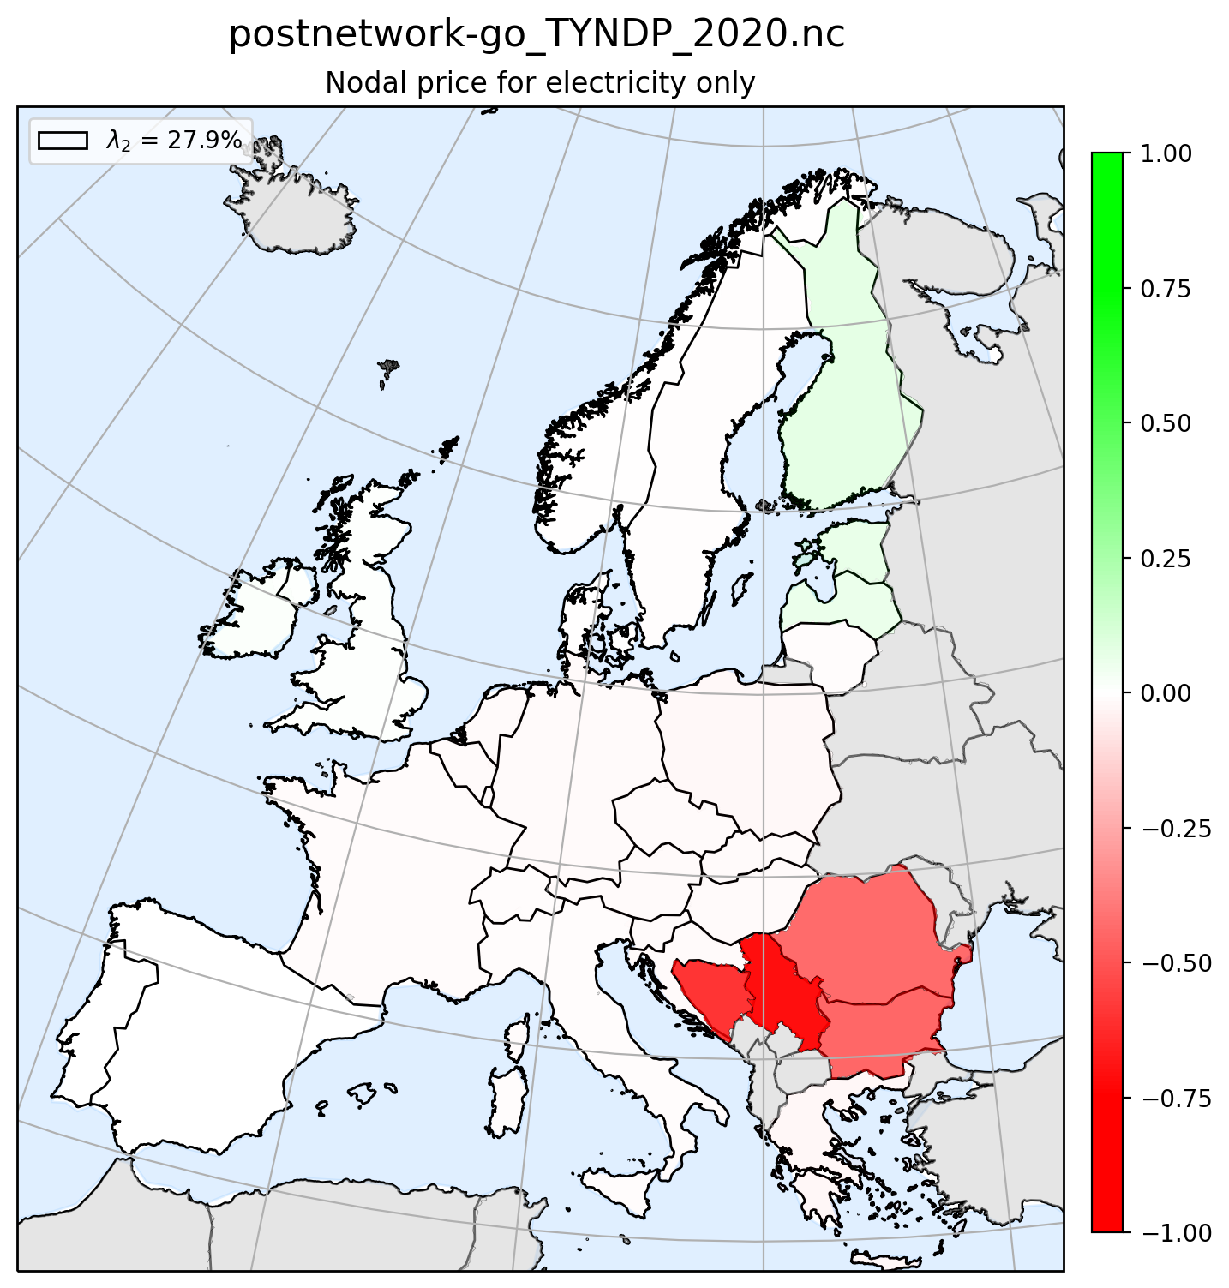
Principle Component 2 - Map plot
Real ENP 2019
Real ENP 2020
Greenfield
Brownfield

Slide 5
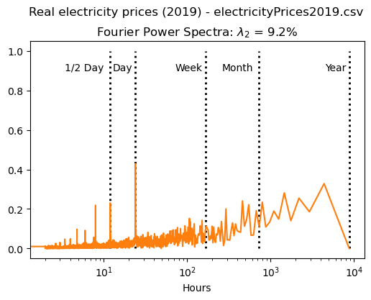
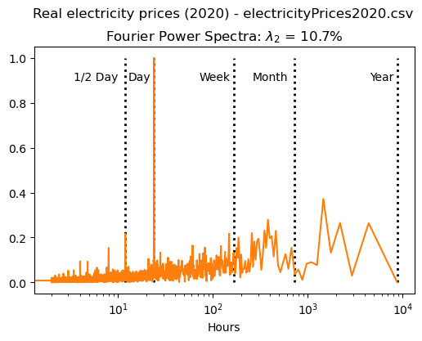
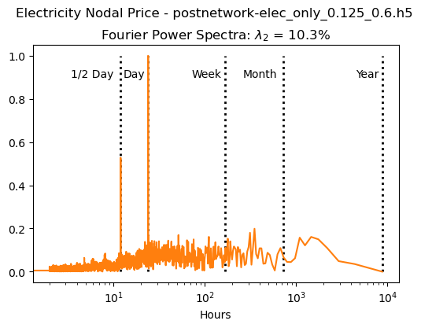
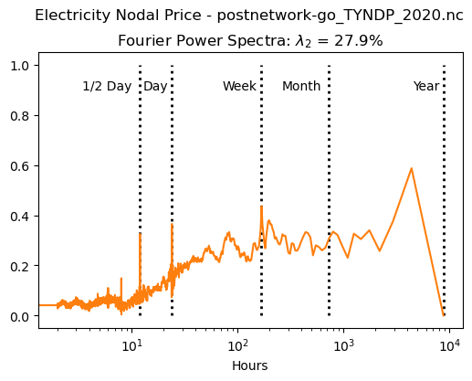
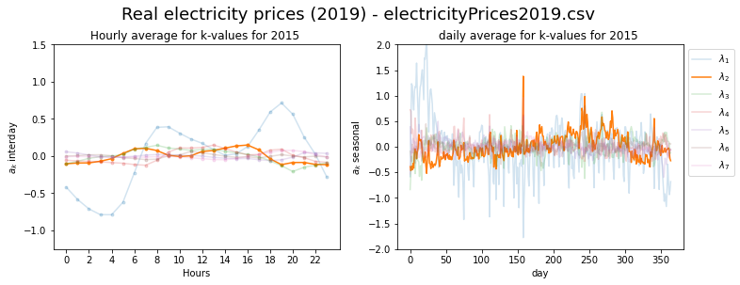
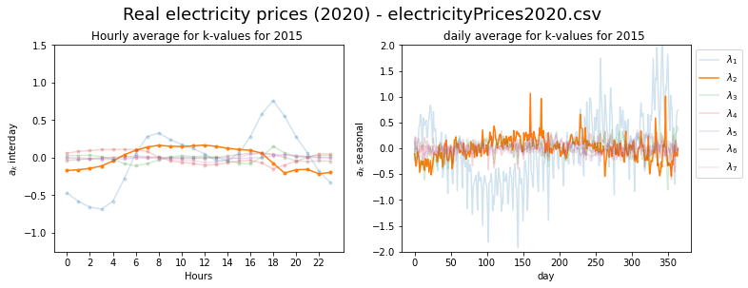
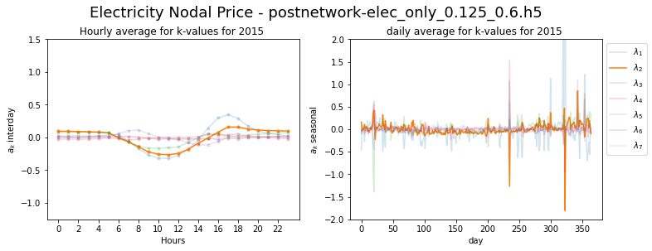
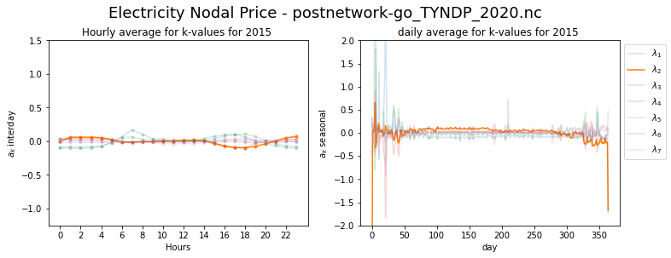
Principle Component 2 - FFT & Seasonal plot
Real ENP 2019
Real ENP 2020
Greenfield
Brownfield

Slide 6
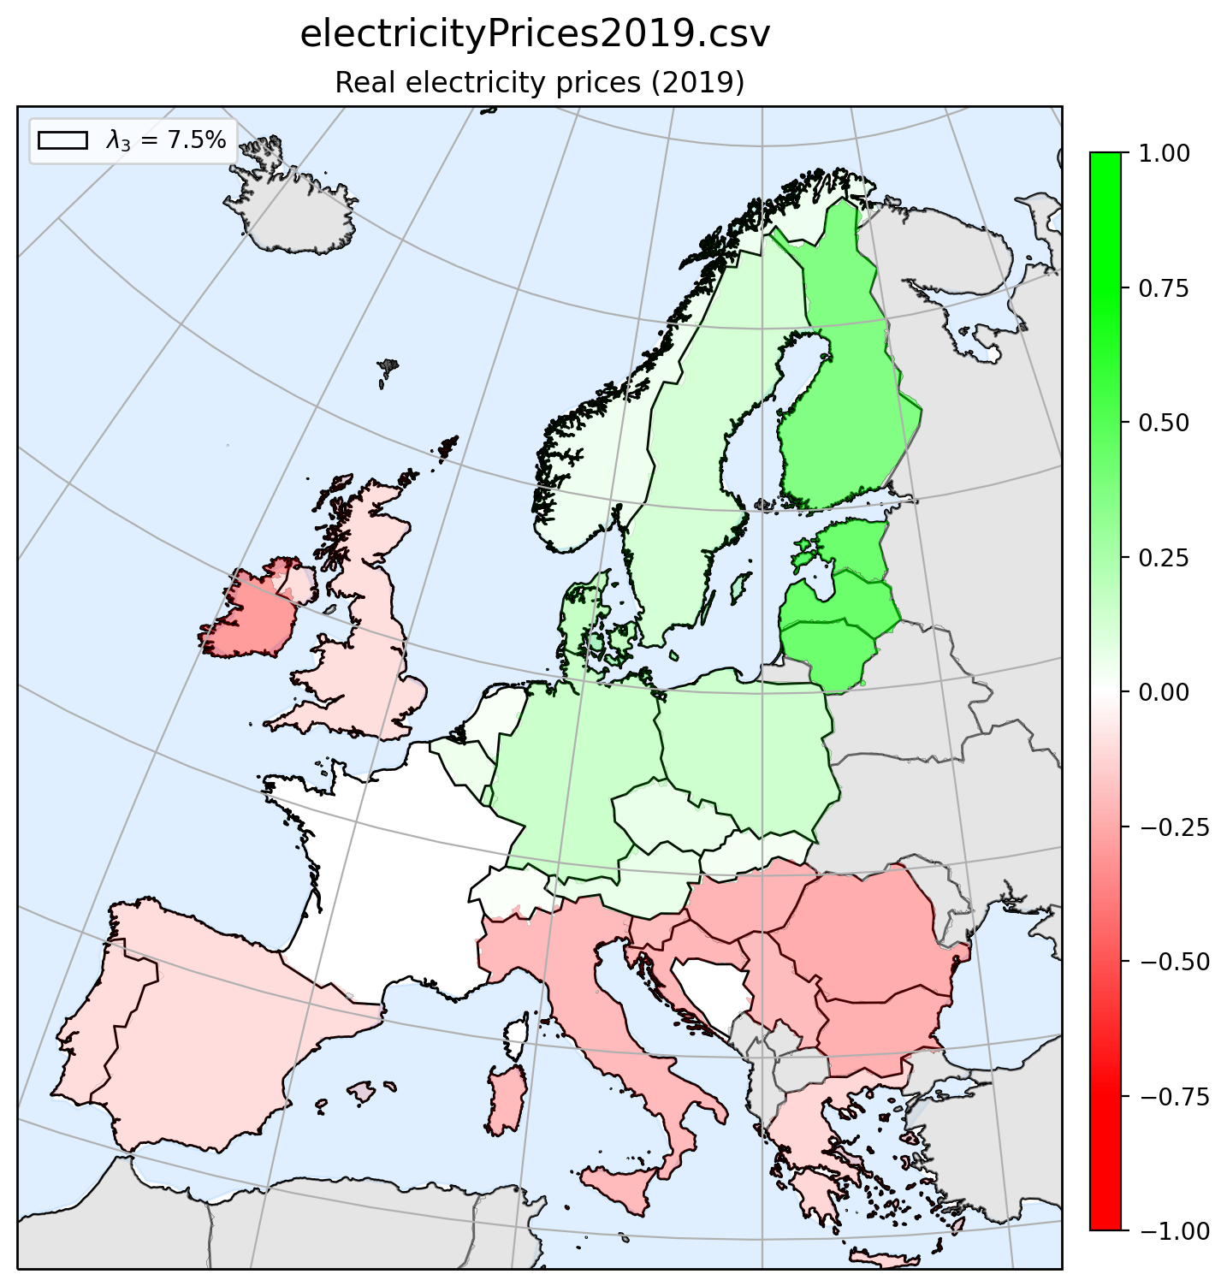
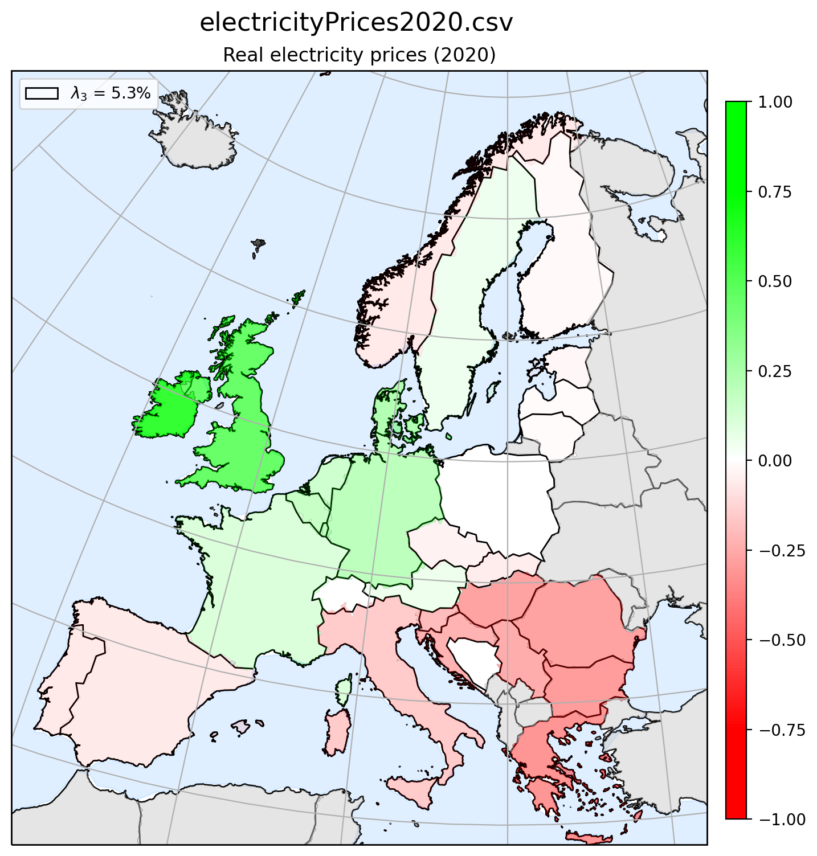
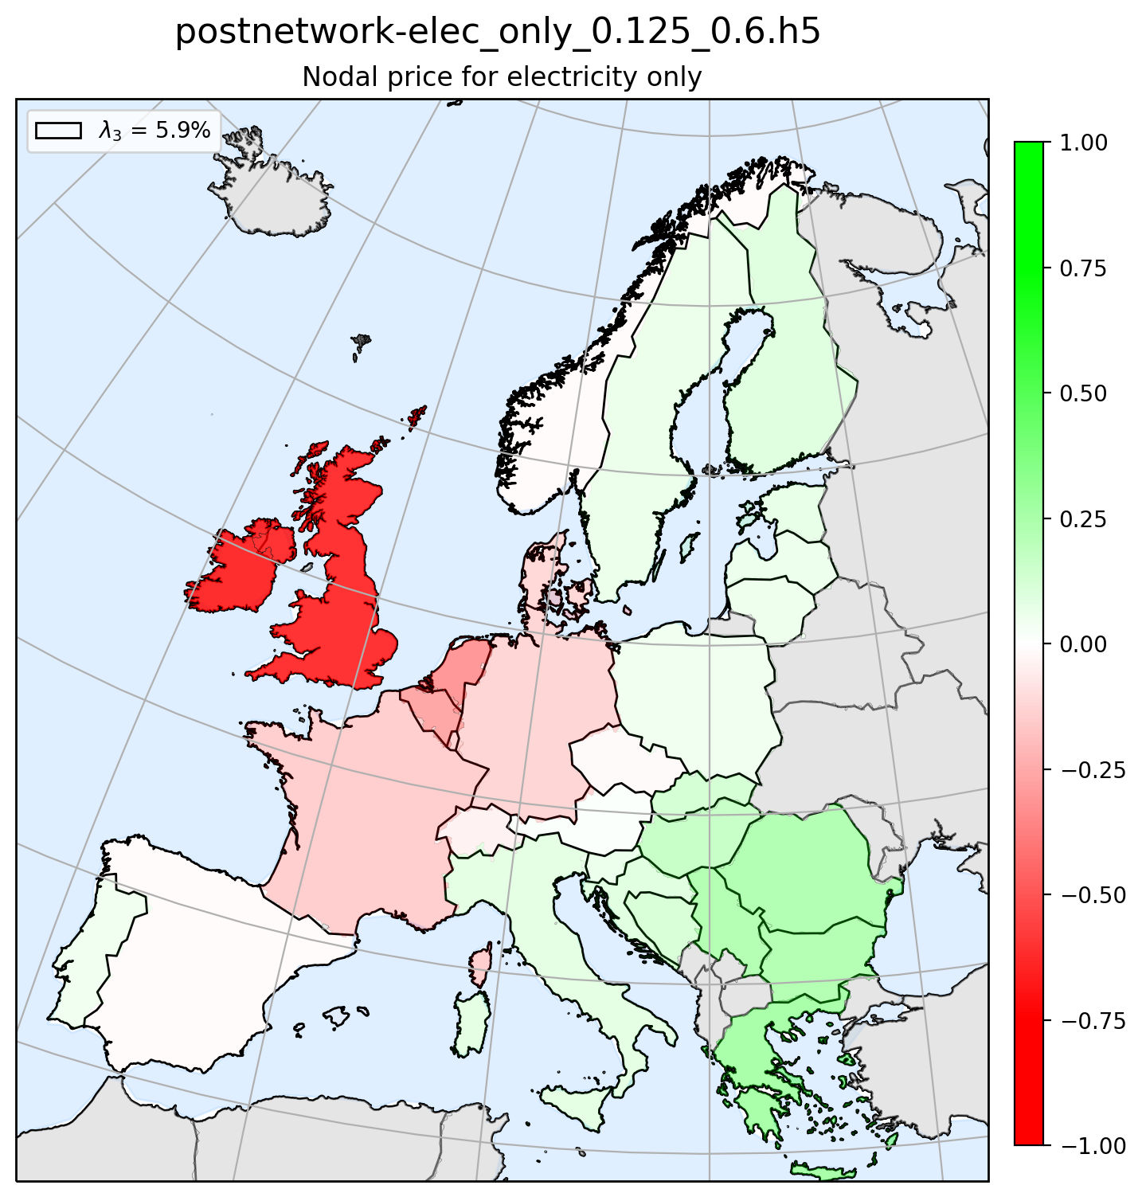
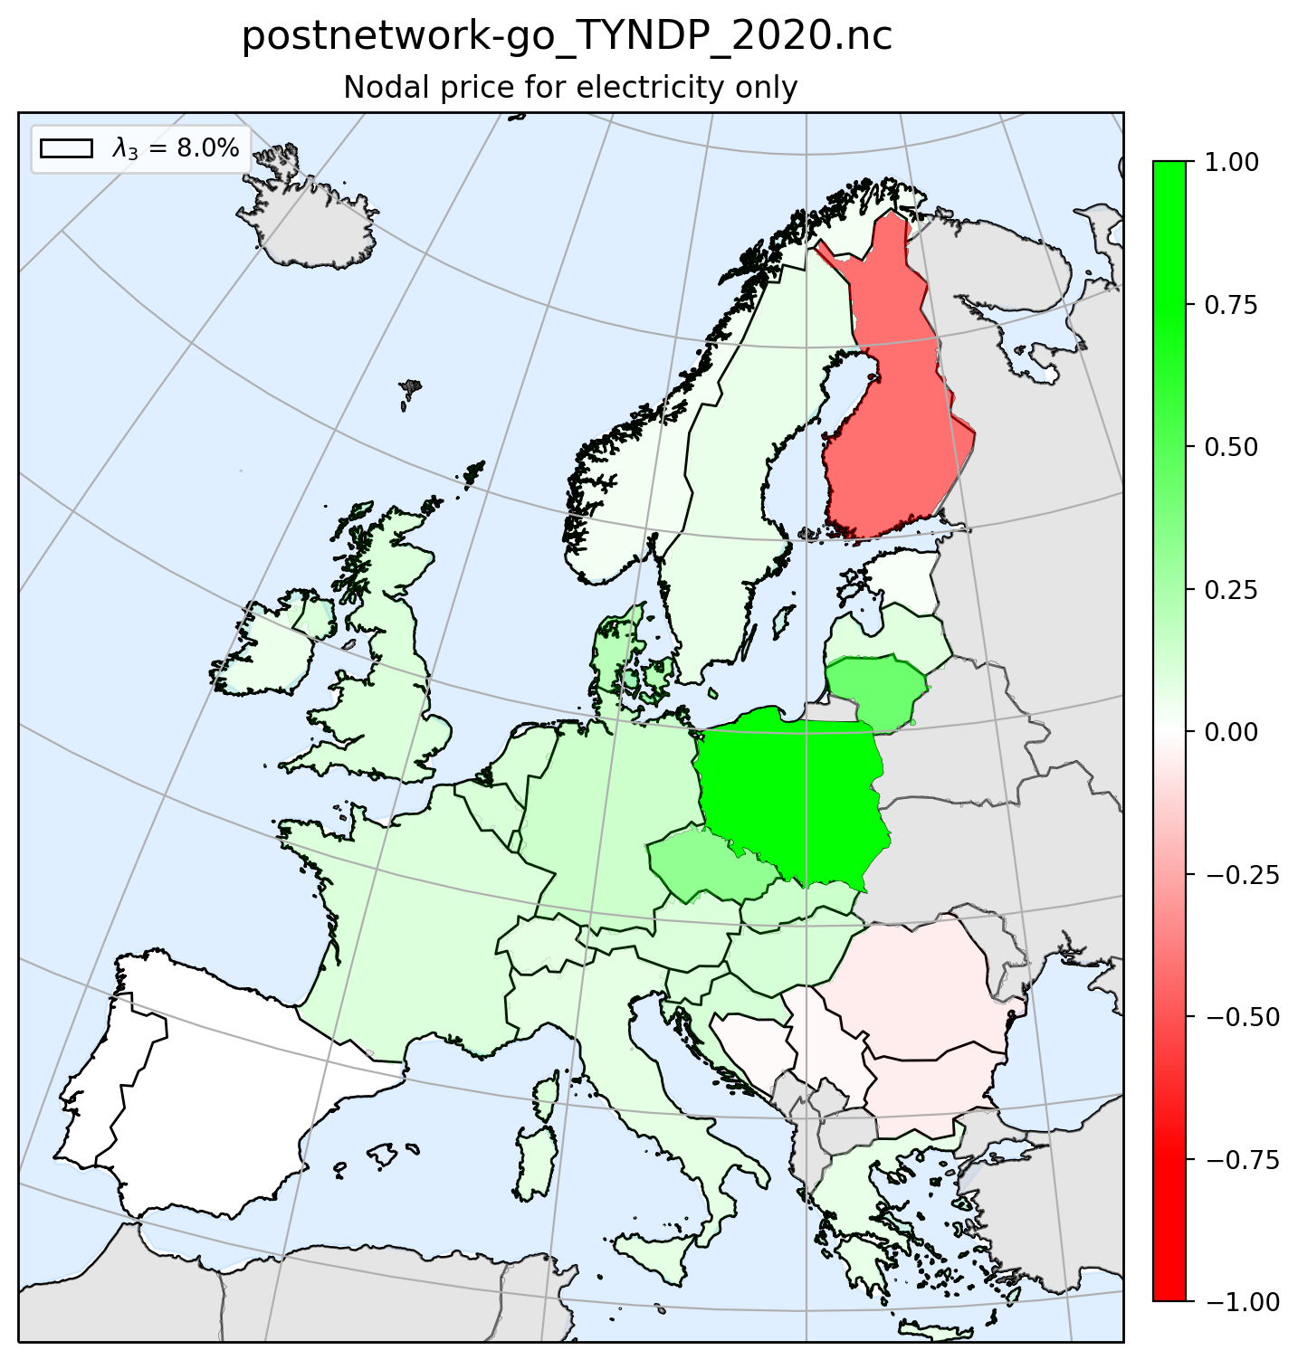
Principle Component 3 - Map plot
Real ENP 2019
Real ENP 2020
Greenfield
Brownfield

Slide 7
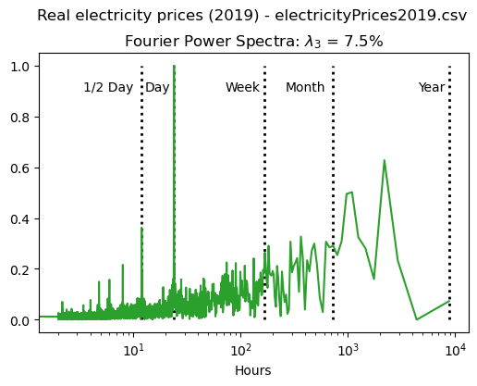
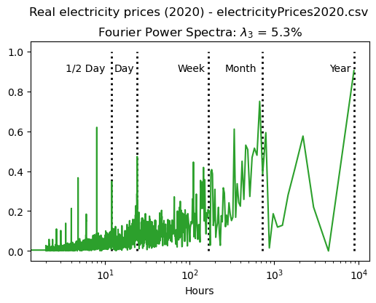
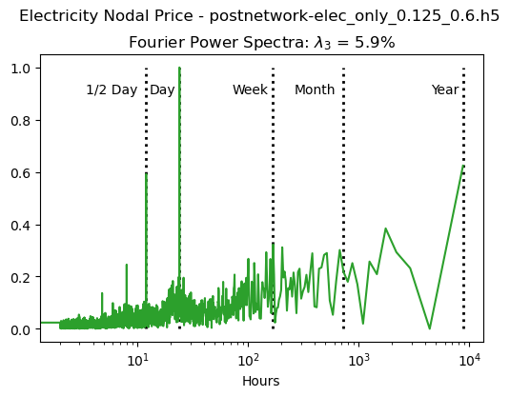
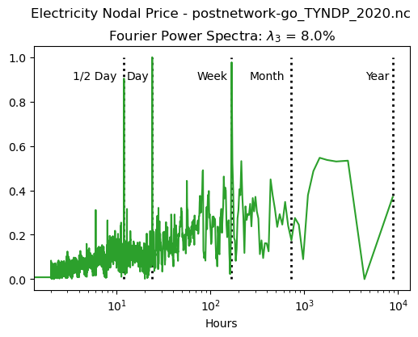
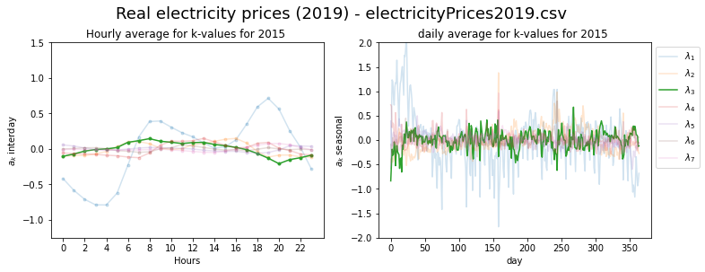
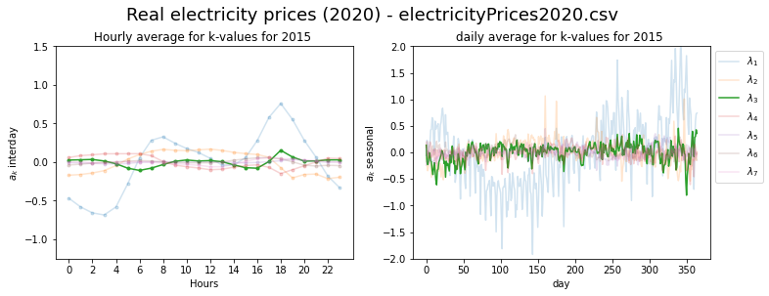
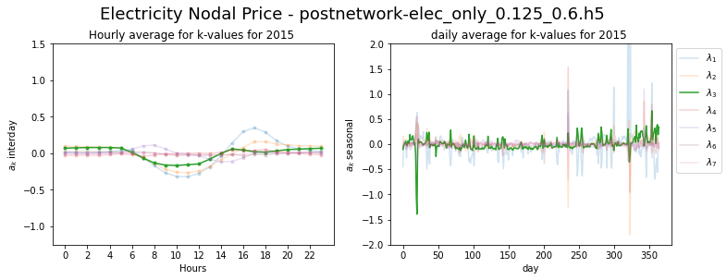
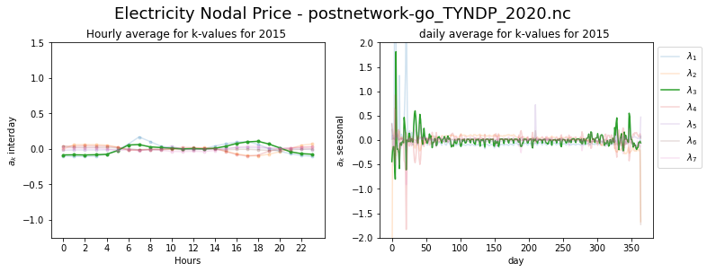
Principle Component 3 - FFT & Seasonal plot
Real ENP 2019
Real ENP 2020
Greenfield
Brownfield

Slide 8
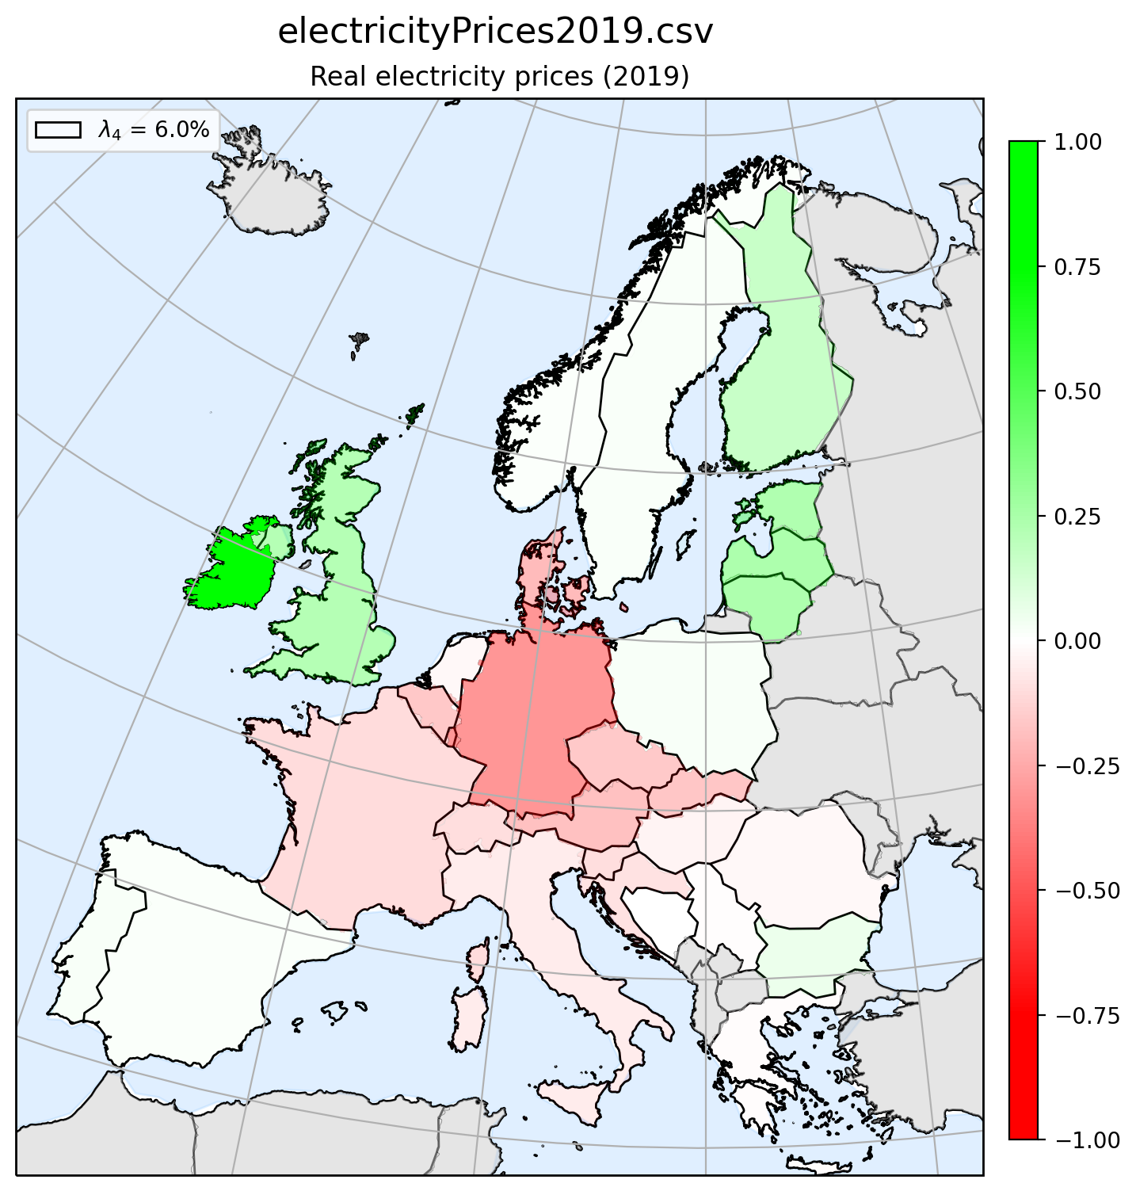
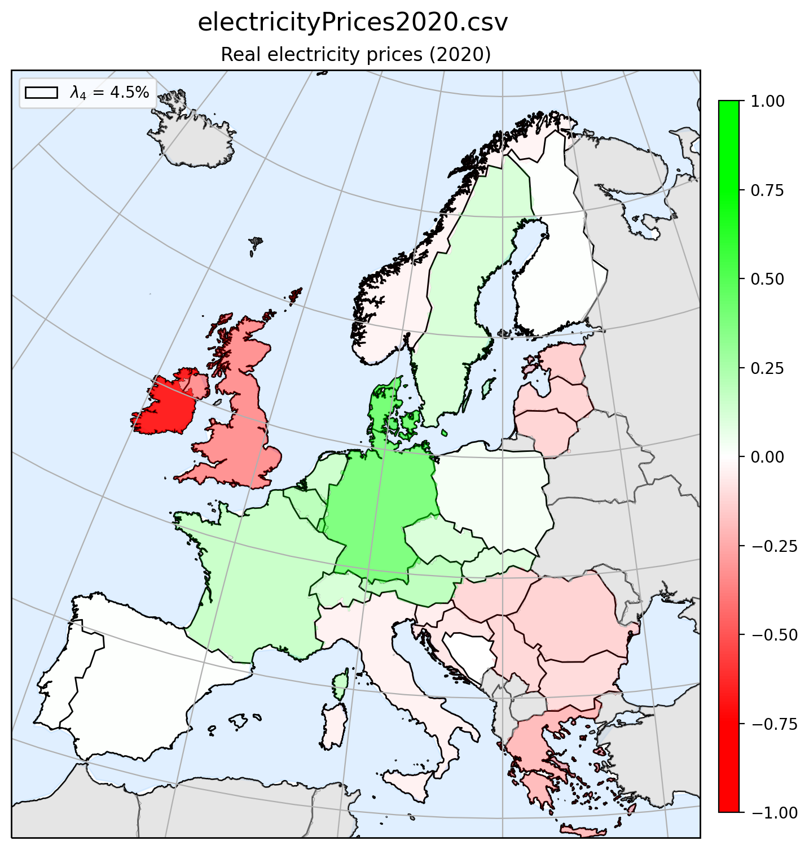
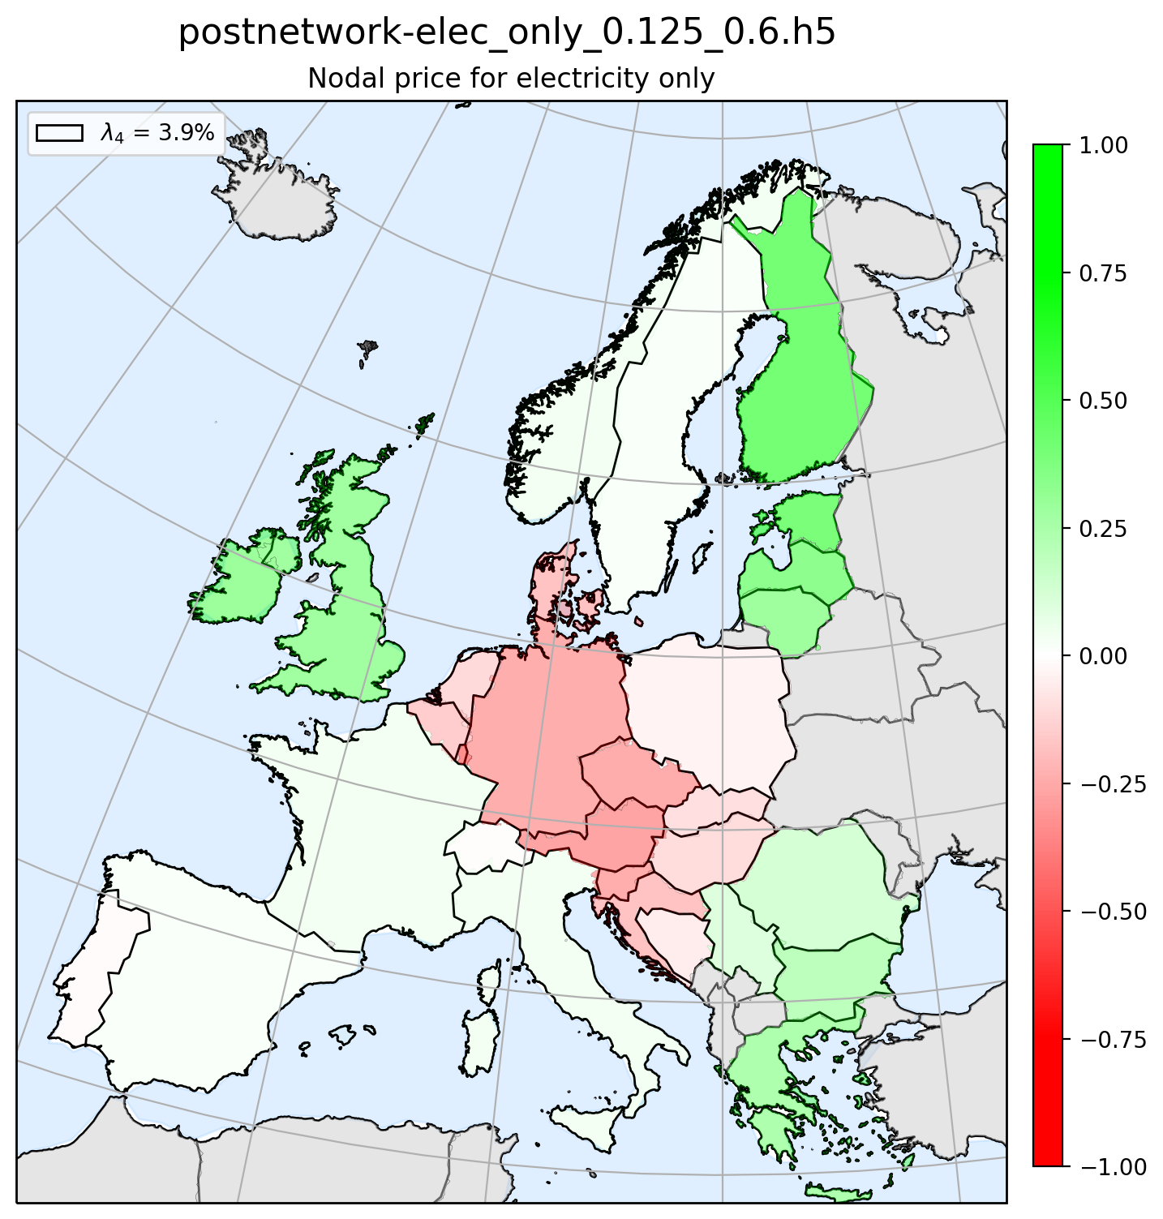
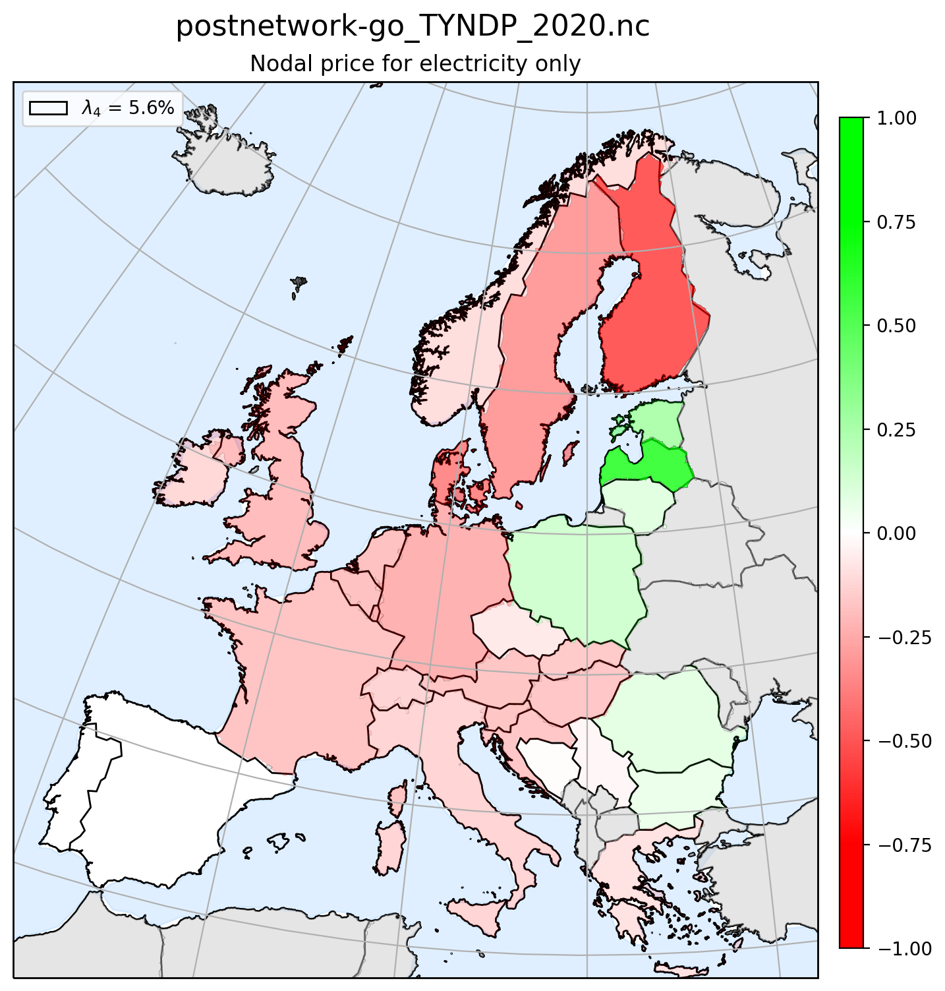
Principle Component 4 - Map plot
Real ENP 2019
Real ENP 2020
Greenfield
Brownfield

Slide 9
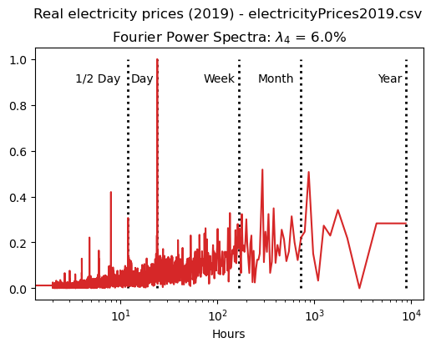
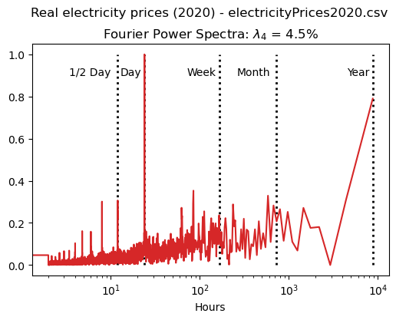
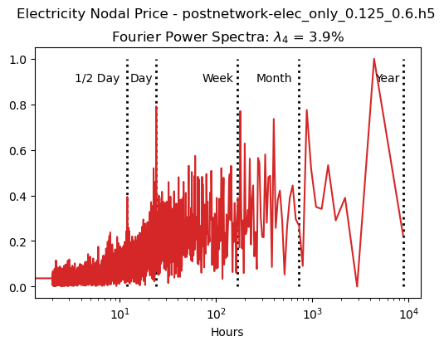
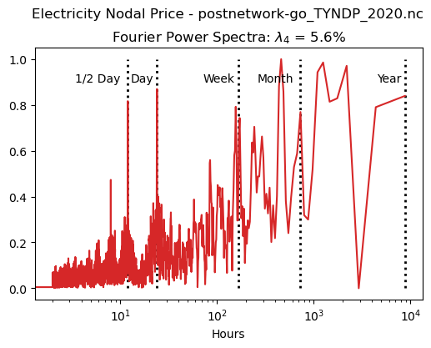
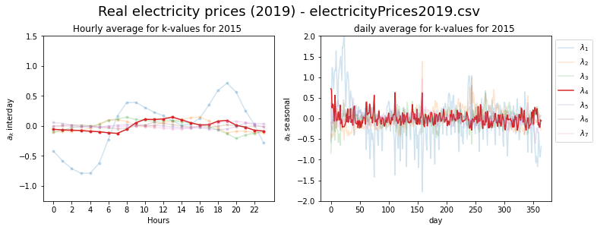
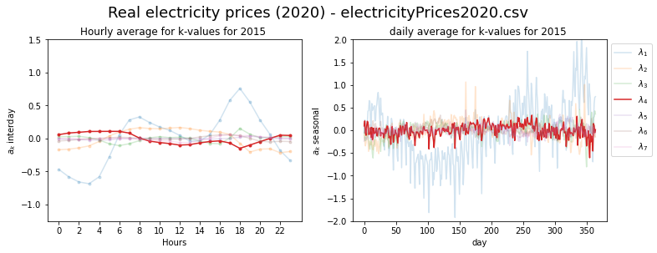
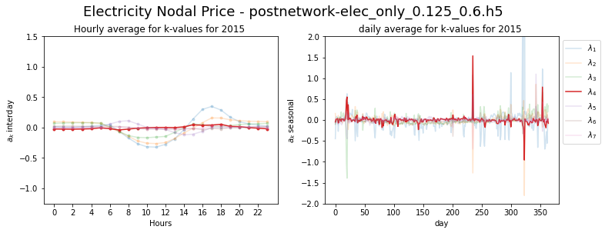
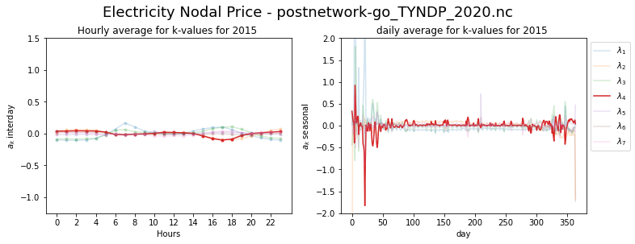
Principle Component 4 - FFT & Seasonal plot
Real ENP 2019
Real ENP 2020
Greenfield
Brownfield

Slide 10
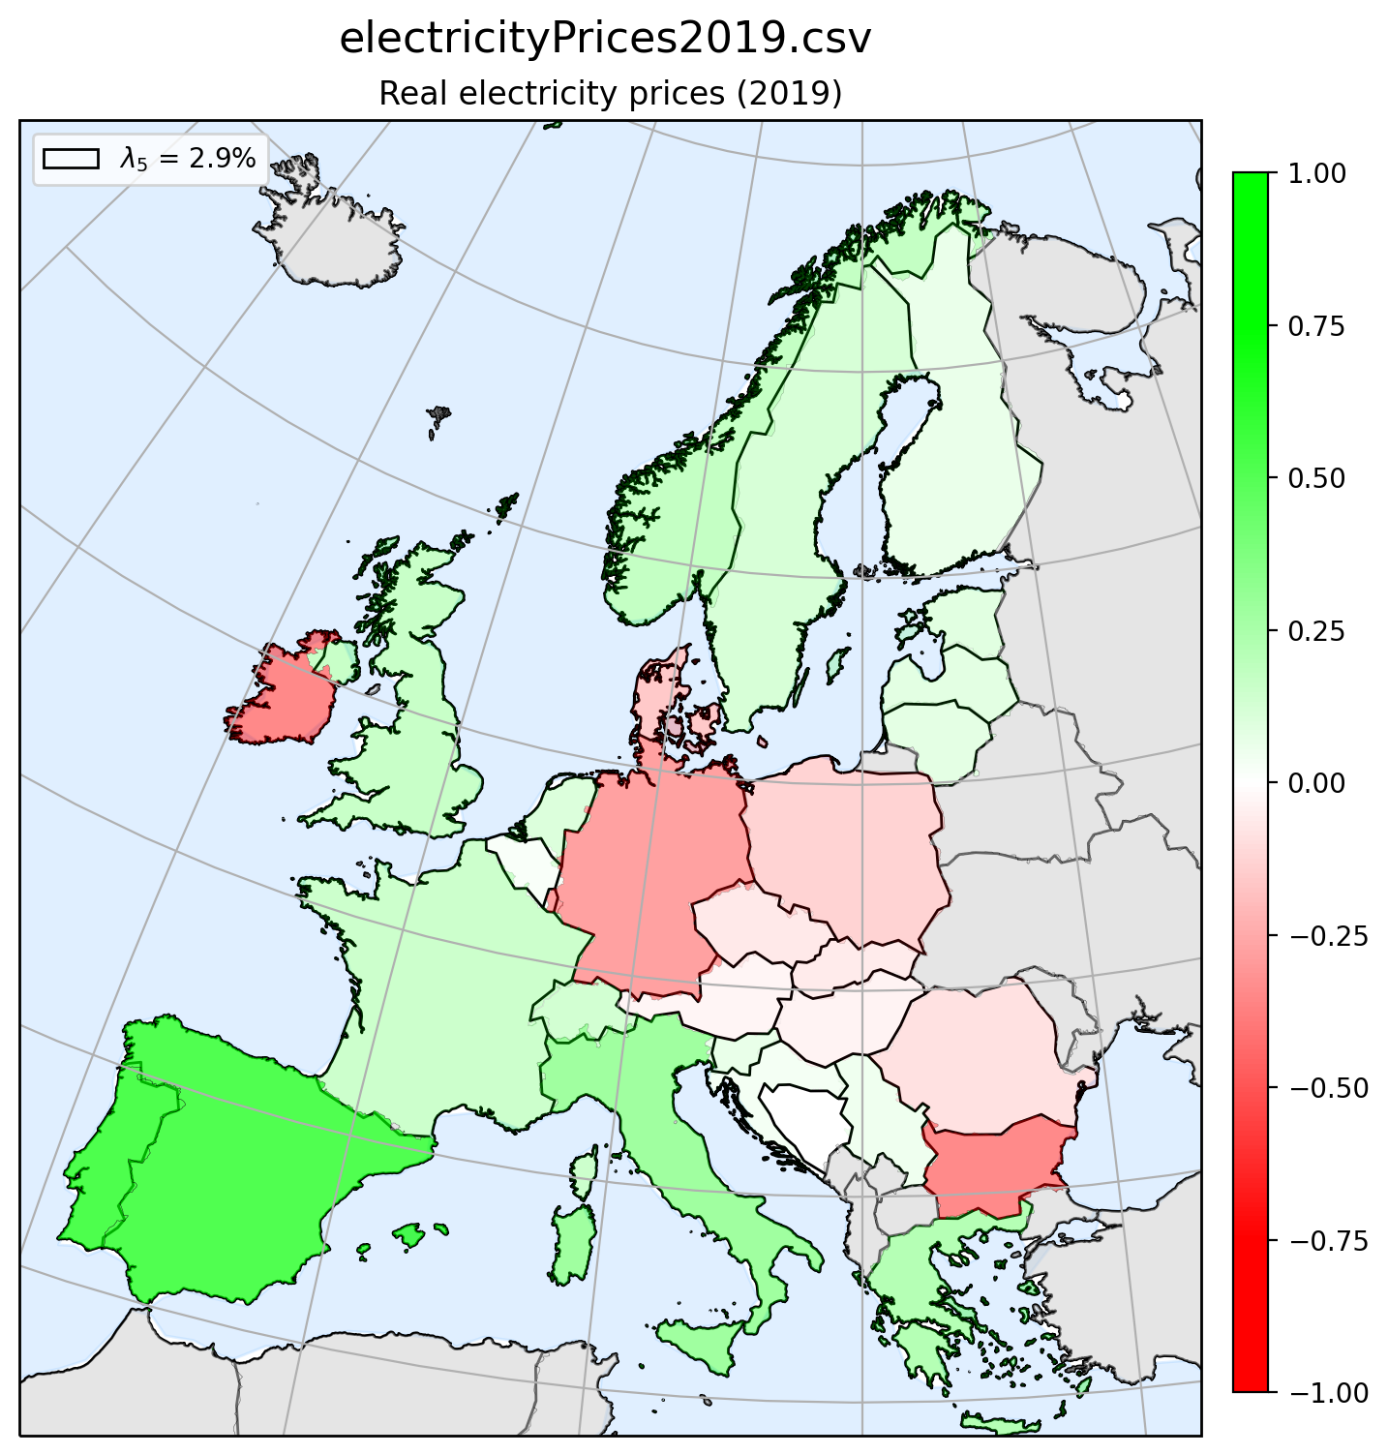
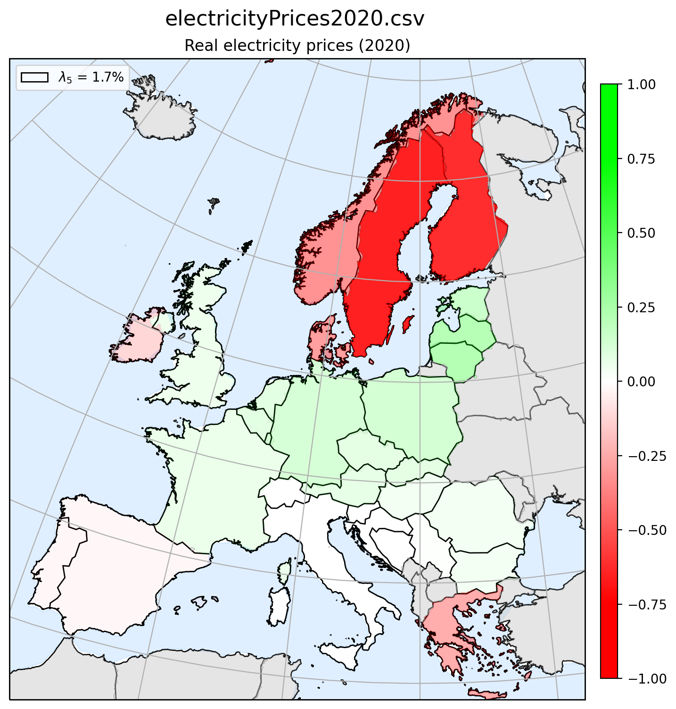


Principle Component 5 - Map plot
Real ENP 2019
Real ENP 2020
Greenfield
Brownfield

Slide 11








Principle Component 5 - FFT & Seasonal plot
Real ENP 2019
Real ENP 2020
Greenfield
Brownfield

Slide 12




Principle Component 6 - Map plot
Real ENP 2019
Real ENP 2020
Greenfield
Brownfield

Slide 13








Principle Component 6 - FFT & Seasonal plot
Real ENP 2019
Real ENP 2020
Greenfield
Brownfield

Slide 14
Real Electricity Nodal price
Coherence between real ENP (2019 & 2020), Greenfield optimization ENP and Brownfield optimization ENP

Slide 15



Coherence Method 1

Slide 16


Coherence Method 1

Slide 17



Coherence Method 2

Slide 18


Coherence Method 2

Slide 19



Coherence Method 3

Slide 20


Coherence Method 3

